Slide 1

Temporal Change in Open Water Surface (2013–2025): Brookings County, SD
Agricultural Remote Sensing
Final Project
Ashish Chaudhary
Agronomy, Horticulture, and Plant Science Department
12/8/2025

Slide 2
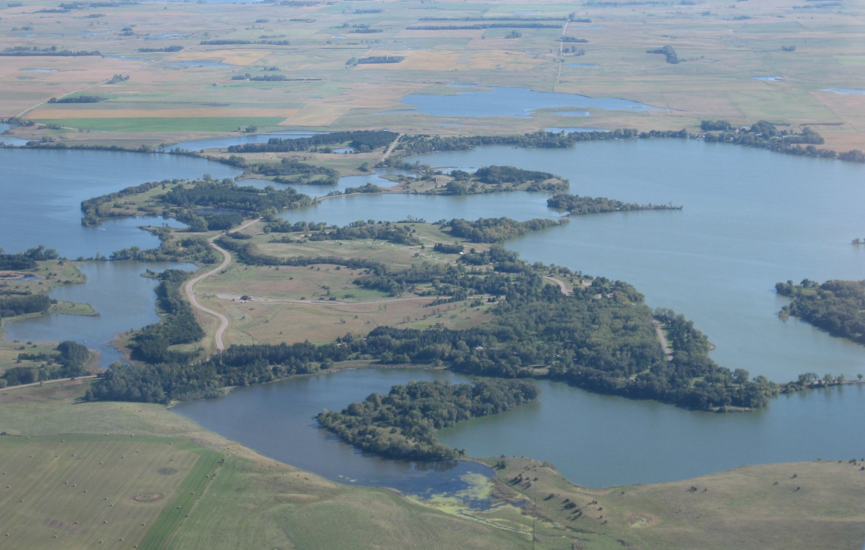
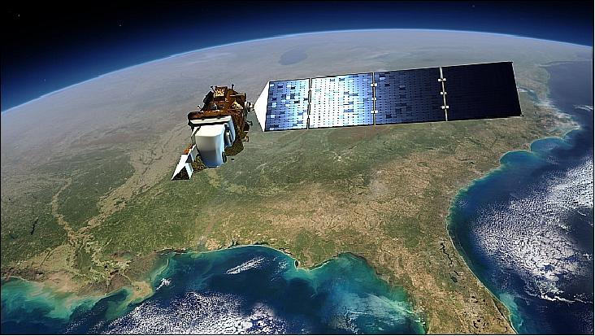
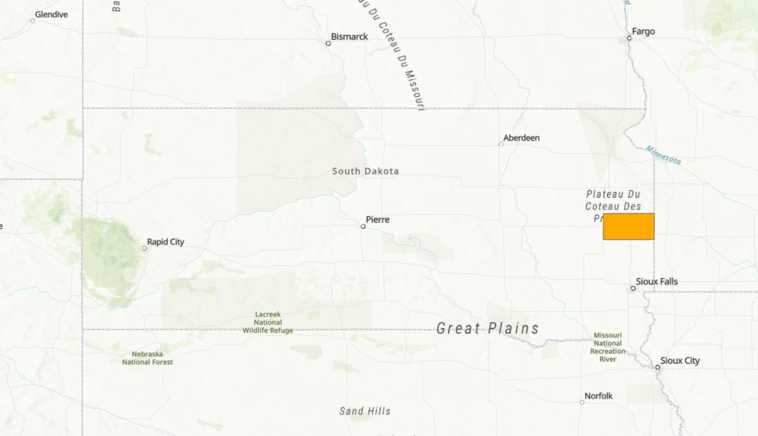
Why This Study Matters?
Landsat Imagery:
Open Water Surface Area:
Open Water is:
12.7 mi² (33 km²)
(US Census 2012)
2013 - 2025
Important environmental indicators
Rainfall patterns
Drought conditions
Land use changes
Climate variability

Slide 3

How The Analysis Was Done?
Data and Preprocessing:
Processing Steps:
Year | Image Date
2013 | July 12th
2014 | June 29th
2015 | July 18th
2016 | July 20th
2017 | July 7th
2018 | May 7th
2019 | May 10th
2020 | June 13th
2021 | May 31st
2022 | July 21st
2023 | July 24th
2024 | July 26th
2025 | July 13th
Landsat Bands 3 (Green) and 5 (NIR)
(www.earthexplorer.usgs.gov)
July → June → May
Reflectance normalization:
Reflectance = Digital Number * 0.0000275 – 0.2
Normalized Difference Water Index:
NDWI = $\frac{(Green − NIR)}{(Green + NIR)}$ (McFeeters, 1996)
Extracted Brookings County
Extract by Mask
Reclassify NDWI:
-0.1 threshold
Water Area:
Pixel count * 0.03 * 0.03 km²

Slide 4
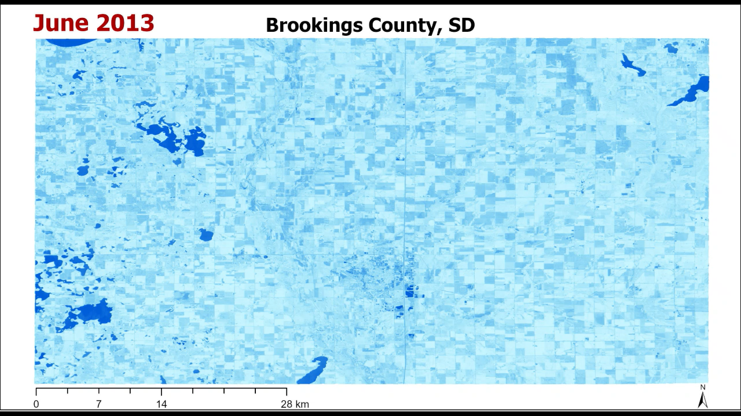
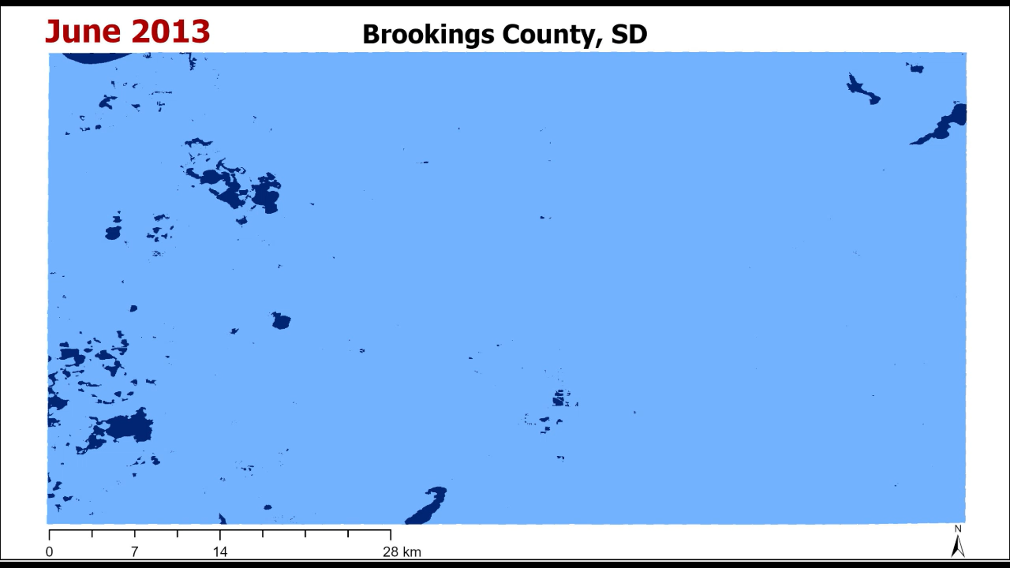
Changes in Water Surface Over Time
NDWI Map
NDWI Map
Reclassified NDWI Map

Slide 5
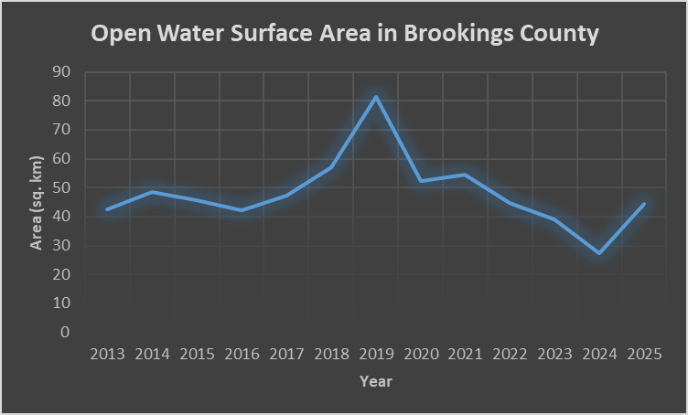
Final Insights
NDWI effective for mapping open water
Water surface area varies annually
Useful for hydrology and land management planning
Notes:
This study demonstrates that NDWI from Landsat is a simple and effective tool to monitor long-term water dynamics.
The workflow is reproducible and can be expanded to other counties or larger regions.

